Slide 1
Cognizant Business Consulting
BFS Overview – Part 1
Banking & Payments
Notes:
Use the slides to provide background and context to enable you to give your personal perspective on what ‘being’ a consultant entails.
There are several ‘prompting’ questions on the slides – please use them to elicit a roundtable conversation. It will be particularly interesting if any of the participants have employed consultants during past industry roles.

Slide 2






Evolving BFS Landscape
Changing Customer Needs & Preferences
Shifting Competitive
Landscape
Increasing Expectations among Stakeholders
Evolving Security &
Risk Issues
Emerging Channels & Payment Methods
Evolving Regulatory
Environment

Slide 3

We see similar response to these changes…
Key Focus Areas / Business Responses
Changing Customer Needs & Preferences
Shifting Competitive
Landscape
Effective channel strategy
Increase focus on innovation of customer-centric products and services
Hyper personalize targeting & cross-sell
Drive innovative products & pricing models
Explore acquisitions & partnerships
Emphasize on execution excellence & effectiveness
Increasing Expectations among Stakeholders
Evolving Security &
Risk Issues
Build synergetic programs with banks
Focus on loyalty programs including merchant-funded loyalty programs
Enhance risk management
Build comprehensive fraud management techniques
Adopt advanced & predictive analytics
Emerging Channels & Payment Methods
Evolving Regulatory
Environment
Create differentiated offerings through latest technology
Support alternative payment networks
Leverage mobile & social
Ensure adherence & conformity to regulations
Reduce compliance costs & time-to-market
Emphasize on data quality & accurate MIS

Slide 4
Banks…Functions
Financial institution that is licensed to accept deposits and issue loans
Functions
Channelize Savings
Provide credit facilities to borrower
Provide investment avenues to investors
Facilitate trade and commerce dealings
Provide financial backbone to support economic growth of the country
Minimize Cash Transactions
Provide Services

Slide 5
Central Bank
Banker’s bank & Government’s bank
Acts as a regulator for other banks
Functions
Conducting the nation's monetary policy
Supervising and regulating banking institutions and protecting the rights of consumers
Maintaining the stability of the financial system, i.e. stability of interest rates and foreign exchange rate.
Ensuring that the interest rates remain at a viable level
Providing certain financial services to the government, the public, financial institutions, and foreign official institutions
Monitoring the foreign currency assets and liabilities and monitoring the inflow and outflow of foreign currency

Slide 6
The Bank – Customer Equation
Products & Services
Channels
Experience
Business Model
Banking Functions / Departments
Customer Centric Banking – Experience – Customer Engagement Life Cycle
Regulations

Slide 7

Banks and their Dimensions
Personal / Business - Channels

Slide 8
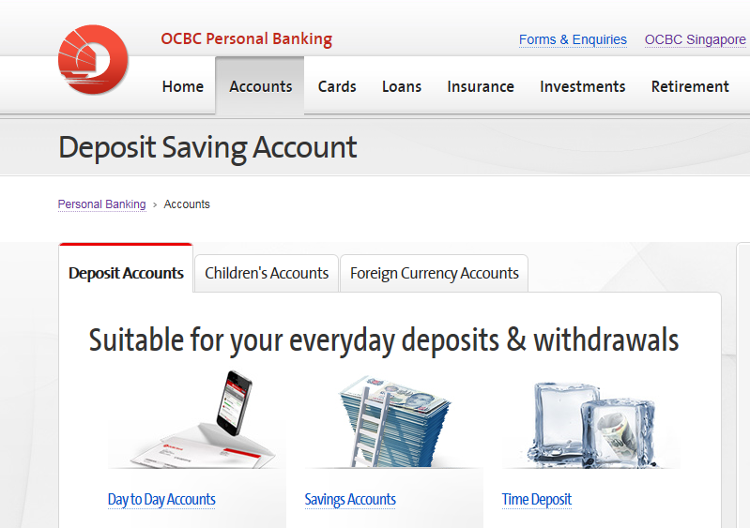
Personal Banking (Retail)
Types of Products, Business Model, Features, Customer Life Cycle

Slide 9
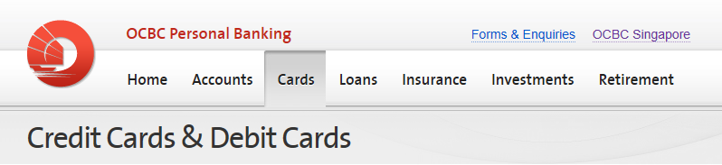



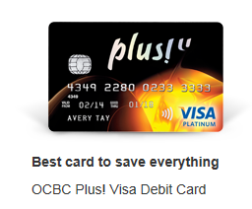
Cards (Card& Payments)
Credit Vs Debit
Transaction Entities – Business Model
Stripe / EMV – Authentication
Channels – Mobile Wallets, Online
Loyalty – Card Statements – Billing / Payment Cycle – Retail Payments / Fund Transfers / Remittances
Customer Life Cycle

Slide 10


Payments
Clearing House Inter-bank Payment System (CHIPS)
Society for Worldwide Inter-bank Financial Telecommunication (SWIFT)
ACH
Electronic Collections – GIRO, FAST

Slide 11
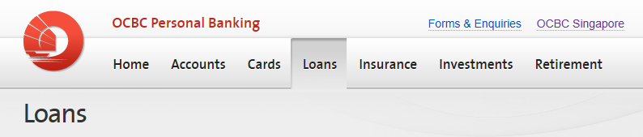


Loans (Retail / Consumer lending)
Asset based vs non asset based
Secured vs Unsecured
Asset Ownership – Eligibility – Repayment – EMI – Tenure – Risk Premium – Principal – Interest (Floating / Fixed etc.)
Lending Process
Channels
Customer Perspective
Asset Securitization – Secondary Market Players – Sub Prime Lending

Slide 12
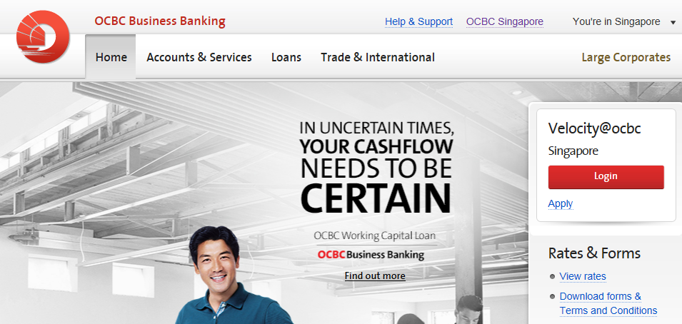
Business Banking (Wholesale Banking)
Commercial Lending
Cash Management
Trade Finance
Treasury Services

Slide 13
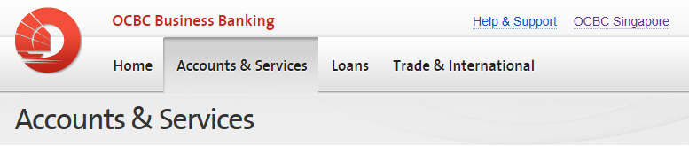

Corporate Accounts

Slide 14

Cash Management
Corporates need to manage cash well since they have:
Payments to multiple parties at various locations
Collections from multiple parties at various locations
Multiple banking accounts at various locations

Slide 15
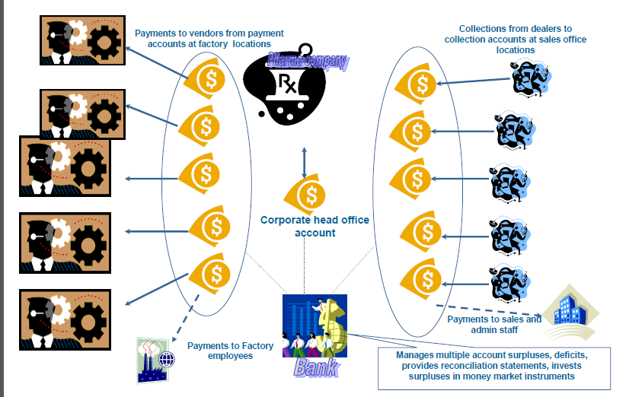
Overview

Slide 16
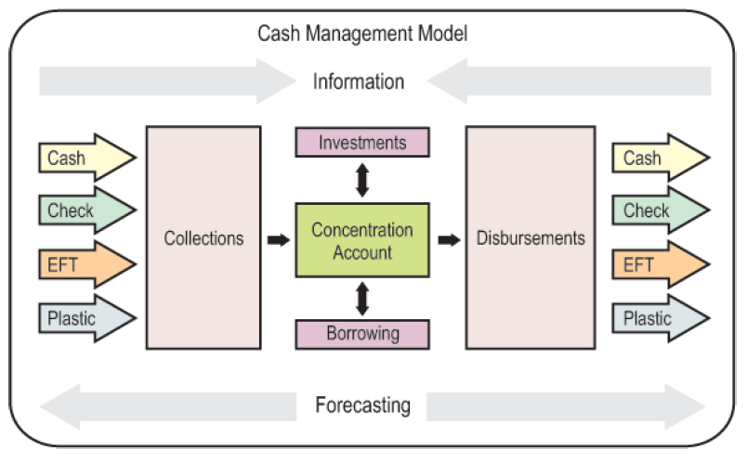
Key Components

Slide 17
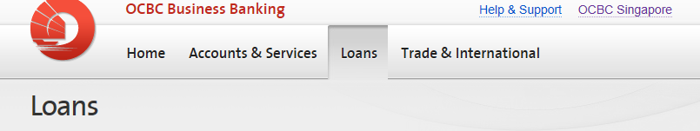

Corporate Loans (Commercial Lending)
Term loans – Long term & short term
Corporate bonds
Working capital loans – Short term loans and overdraft limits
Lines of Credit
Bill discounting
Commercial paper
Leasing
Supplier and dealer loans
Asset Securitization loans

Slide 18
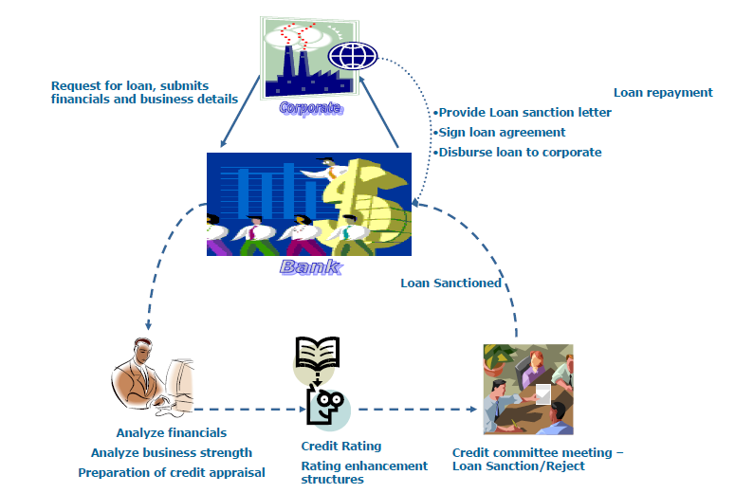
Corporate Lending Process
KYC
CDD
Credit Rating - Limits
(Accounting and Corporate Regulatory Authority (ACRA))
Syndication

Slide 19

Trade Finance
Trade Finance
The buying and selling of goods and technology between countries, by means of various modes of transport like aircraft, railway, truck, ship or a combination of two or more modes of transport, involving different parties across the Globe.
International Trade Finance Industry Comprises of Importers/Exporters, Banks, Shipping Co./Agents.

Slide 20
Banks Roles
Acceptable as an intermediary – various roles
Expertise in handling international trade transactions.
Ability to supply trade and credit information
Assurance regarding quality of goods
Guarantees payment
Financial assistance
Other Aspects:
Costs - Interest & Fee
Time Frame - Short Term, Medium Term, Long Term
Risk Factors - Buyers’ credit rating, Country/political risks
Government Guarantee Programs - Exporters’ Funds, Expert credit verification,
Risk assessment

Slide 21
Payment Methods
Cash in Advance
Commercial Letter Of Credit
Documentary Collection
Time Drafts/Bankers' acceptances
Open Account
PRE SHIPMENT LOANS - Working capital finance
POST SHIPMENT LOANS - Liquidity needs, Bills Discounting

Slide 22
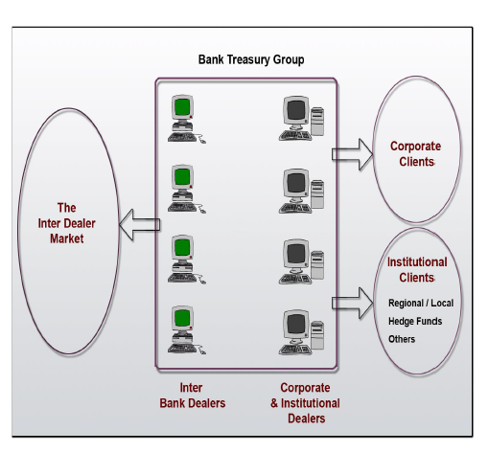
Treasury Services
Ensure availability of funds
Manage all foreign currency transactions for the bank
Manage various risks:
Liquidity – risk of asset and liability cash flow mismatch
Interest rate – risk due to volatility of interest rates
Currency – risk due to volatility in exchange rates
Commodity – risk due to volatility in commodity prices
Streamlining clearing & settlement, collections, payments

Slide 23
Cognizant Business Consulting
BFS Overview – Part 2
Capital Markets and Risk Management
Notes:
Use the slides to provide background and context to enable you to give your personal perspective on what ‘being’ a consultant entails.
There are several ‘prompting’ questions on the slides – please use them to elicit a roundtable conversation. It will be particularly interesting if any of the participants have employed consultants during past industry roles.

Slide 24
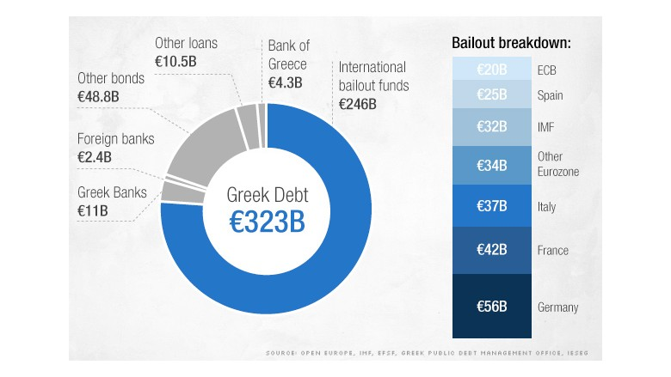


'Greek Debt Crisis'

Slide 25
Capital Markets … why are they needed?
Financial institutions that facilitate transfer of capital
Central tenant – Balance 'Risk and Return'
Flow of capital is the life-blood of an economy
Enables
Governments
Financing their programs
Planned and Unplanned expenses
Institutions
IMF, World Bank, Quasi-government agencies
Specialized agencies setup for specific objectives
Businesses
Growth plans
Investments
Mergers & Acquisitions
Individuals
Wealth
Credit
Retirement, Pension, Insurance etc.

Slide 26
House of 'Capital Markets'
Investment Banking and Brokerage
Security Services
Asset and Wealth Management
'Sell Side'
Sellers of Securities
Investment Banks
Brokerage Firms
Broker Dealers
Prime Brokerage
'Facilitate the trade'
Exchanges
Clearing Houses
Depositories
Transfer Agencies
Custody Services
Data Providers
Ratings Agencies
Market and Reference Data providers
'Buy Side'
Buyers of Securities
Mutual Funds
Pension Funds
Sovereign Funds
Asset Managers
Alternate Investment & Hedge Funds
Private Banks
Wealth Managers
'Regulators'
Regulatory Compliance & Risk Management
Government, Quasi-Government agencies

Slide 27





















The 'Marketplace'
Clearing Houses / Depositories
Buy Side Firms
Broker Dealers / Prime Brokers
Asset Servicing Firms
Market Data
Providers

Slide 28
Investment Banking and Brokerage
Investment Banks assist clients in raising money in order to grow and expand their businesses.
The areas covered are:
Corporate Finance
Sales
Syndicate
Research
IPO
Underwriting
Secondary market trading
The basic brokerage function is to bring a buyer and seller together. The other functions are:
Dealer function – buying (bid) and selling (ask) from an inventory of securities owned by the seller.
Providing loans to customers, who invest the margin proportion and borrow the rest.

Slide 29


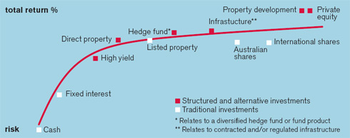

Asset & Wealth Management
Traditional Investment Management
Mutual Funds
Retirement Plans
Managed Accounts
Institutional Asset Management
Fund of Funds, ETFs
Alternate Investments
Hedge Funds
Private Equity
Real Estate – REITs
Special Investment Vehicles
Wealth Management
Private Banking
Financial Advisory
Family Office
Trusts/ Private Investment Companies

Slide 30
Asset and Wealth Management Industry Challenges – A “New Normal”
Less inflows, more competition
Steep fall in AUM
Complex new product structures
New regulations
Change in operating models, sourcing strategy
Improve client interaction and relationship management
Need sophisticated data management practices and infrastructure
New sales tools, use of BI / analytics
Redesign / replace inefficient operations, STP
Technology rationalization
Mergers / de-mergers
Increased due diligence by clients
Enhanced risk perception
Changing demographic, retiring population
Cost / margin pressures
© 2010, Cognizant Technology Solutions. Confidential

Slide 31
Security Services
Services to Issuers of Securities
Investor Services (Transfer Agents)
Securities Borrowing
Collateral Management
Services to Sellers of Securities
Fund Administration
Custody Services
Asset Services
Securities Lending
Market Entities
Exchanges
Depositories
Clearing House
Third Party Agencies
Reference & Market Data Services
Credit Rating Agencies

Slide 32
Risk Management - What is it?
Risk is any element of the environment which can cause a loss or failure
Some of the major risks which affect the financial institutions are:
Market risk
Liquidity risk
Credit risk
Operational risk
The three pillars of risk management are:
Define the risks
Measure the risk
Manage the risk
Market Risk
Risk
Liquidity
Credit Risk
Operational Risk
© 2010, Cognizant Technology Solutions. Confidential
32

Slide 33
Risk Reporting and Compliance
Regulators
US :
Securities & Exchange Commission (SEC), Commodity Futures Trading Commission (CFTC), Federal Reserve System ("Fed"), Financial Industry Regulatory Authority (FINRA)
Europe:
European Central Bank (ECB), European Securities and Markets Authority (ESMA), European Systemic Risk Board (ESRB)
UK:
Bank of England (BoE), Financial Service Authority (FSA)
APAC
Singapore – Monetary Authority of Singapore (MAS)
Hong Kong – Hong Kong Monetary Authority (HKMA), Hong Kong Securities and Futures Commission (SFC)
Role of Regulators
Maintain confidence and financial stability
Ensure order and smooth functioning of the securities markets
Monitor risk and take corrective action
Consumer protection and prevention of financial crime.
Upgrade regulations as per latest trends and technologies and ensure compliance.
© 2010, Cognizant Technology Solutions. Confidential

Slide 34
Is regulation complex?
2008 US Housing Bubble Collapse
“Complex financial instruments allowed Fannie Mae and Freddie Mac to engage in massive misstatements of earnings for years.
So indecipherable were Freddie and Fannie that their federal regulator, OFHEO, whose more than 100 employees had no job except the oversight of these two institutions, totally missed their cooking of the books”
- Warren Buffet, 2008

Slide 35
Harini Ravilochanan
Vishwanath Donti

